Slide 1
COMPANY PROFILE & CREDENTIALS
HARNS — Enterprise Technology & Network Systems
Empowering Higher Education, Healthcare, and SMEs with Custom ERPs, Network Segmentation, and Infrastructure Setup.
Headquarters
Coverage
Contact Email
Eldoret, Kenya
Countrywide & Remote Global
okalc9939@gmail.com

Slide 2

Executive Overview
DIGITAL TRANSFORMATION PARTNER
Bridging Complex ICT Demands with Seamless Automation
Harns delivers end-to-end technological infrastructure, combining custom operational software with resilient physical networking.
Customized ERP platforms for institutional efficiency
High-density network cabling, WiFi, and rack management
Advanced VLAN segmentation and cybersecurity firewalls

Slide 3



Vision & Strategic Directives
Our Vision
Our Mission
Core Promise
Leading ERP solutions and secure network architectures across East Africa and globally.
Empower institutions with tailored technology ecosystems for automated, reliable operations.
Zero-compromise security, maximum system uptime, and local expert support.

Slide 4

Institutional ERP Software
INTEGRATED MANAGEMENT PLATFORMS
Automating Education & Healthcare Workflows
Universities & Colleges: Admissions portals, e-learning, finance, and library automation.
Schools: Student Information Systems (SIS), automated fee collection, and grading.
Hospitals (EMR): Outpatient/inpatient billing, pharmacy inventory, and lab records.
SMEs: Core accounting, inventory tracking, HR, and payroll modules.

Slide 5
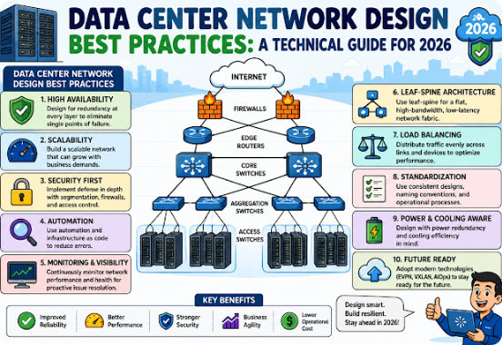
Networking & Security Infrastructure
NETWORK ENGINEERING
Resilient Hardware & Threat Defense
Structured Cabling: Fiber optic backbone and CAT6 LAN deployment across campuses.
Network Segmentation: Isolated VLANs to shield student, administrative, and patient data.
Hardware Racks: Server rack installation, cable management, and climate-controlled cabinets.
Cybersecurity: Next-Generation Firewalls (NGFW) and proactive monitoring systems.

Slide 6
Trusted Institutional Partners
HIGHER EDUCATION
SECONDARY EDUCATION
HEALTHCARE FACILITY
University of Eldoret
High School
Taifa Hospital
Deployed specialized campus ERP modules, high-capacity networking, and ongoing technical support.
Implemented complete student management software and structured computer laboratory networking.
Integrated secure Electronic Medical Records (EMR) with strict patient network data segmentation.

Slide 7
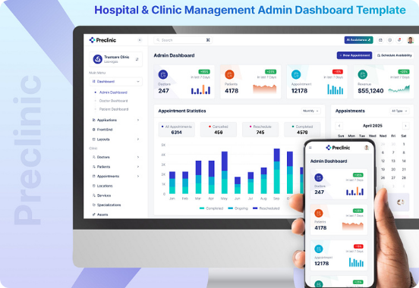
Healthcare Digitization Case Focus
HEALTHCARE SYSTEM ARCHITECTURE
Taifa Hospital EMR & Network Isolation
Harns engineered a zero-downtime health system designed to safeguard critical patient interactions and streamline medical billing.
HIPAA-Compliant EMR Data Handling
Strict Isolation of Medical vs. Guest WiFi Networks

Slide 8
System Deployment Methodology
PHASE 01
PHASE 02
PHASE 03
PHASE 04
Site Assessment
Custom Architecture
Installation
Training & Support
Technical survey of infrastructure, cabling pathways, and system requirements.
Designing tailored ERP software modules and VLAN network maps.
Cabling execution, server rack setup, software deployment, and testing.
Staff onboarding, operational handoff, and 24/7 remote monitoring.

Slide 9
Delivery Scale & Reach
100%
Global
24/7
Kenya Countrywide Delivery
Remote ERP Management
Proactive Network Monitoring

Slide 10
Why Choose Harns?
Generic Tech Vendors
The Harns Advantage
Rigid off-the-shelf software with high renewal fees
Modular ERP tailored directly to institutional workflows
Unsegmented networks leading to data exposure
Strict Zero-Trust VLAN segmentation and firewalling
Delayed off-site support and slow response times
Rapid local support from Eldoret plus global remote reach

Slide 11



Security & Architecture Principles
VLAN Subnetting
Access Control
Redundant Servers
Isolating administrative records from student and guest bandwidth.
Role-based authentication for sensitive healthcare and financial data.
Automated backup protocols to prevent data loss or server downtime.

Slide 12
PARTNER WITH US
Ready to Elevate Your Technology Infrastructure?
Contact us today to schedule an institutional system demonstration or technical survey.
Direct Contact
Email Inquiry
0719501832
okalc9939@gmail.com

Slide 13




Image Sources
https://www.hanwhadatacenters.com/wp-content/uploads/2025/12/image-9.jpeg
Source: www.hanwhadatacenters.com
https://www.edusyserp.com/Edusys/blog/1_134272003945466230.png
Source: www.edusyserp.com
https://blogger.googleusercontent.com/img/a/AVvXsEhRvr5mjWJCRwnKm-R3vd8nZ_392oJKGGzgLhYl0SV5efc8fuJ2eYBoHNu1MkAMWE0P2YwJ_dlXb1j-7wP9YqkN3CxIcMNOkozLqHBNISwUPjRhla0KkFyi8fjkp8WcID3qQ2GalPOHR7Bj1yf-R1tftKON8C3Lb8pNgA3Xe_DkT_2b9G0iR_kOD0HZYvMD=w640-h426-rw
Source: www.thenetworkdna.com
https://cdn.dribbble.com/userupload/43660615/file/original-2e510606eaaaf5ac8a168add6565dd07.jpg?resize=752x&vertical=center
Source: dribbble.com

